Slide 1
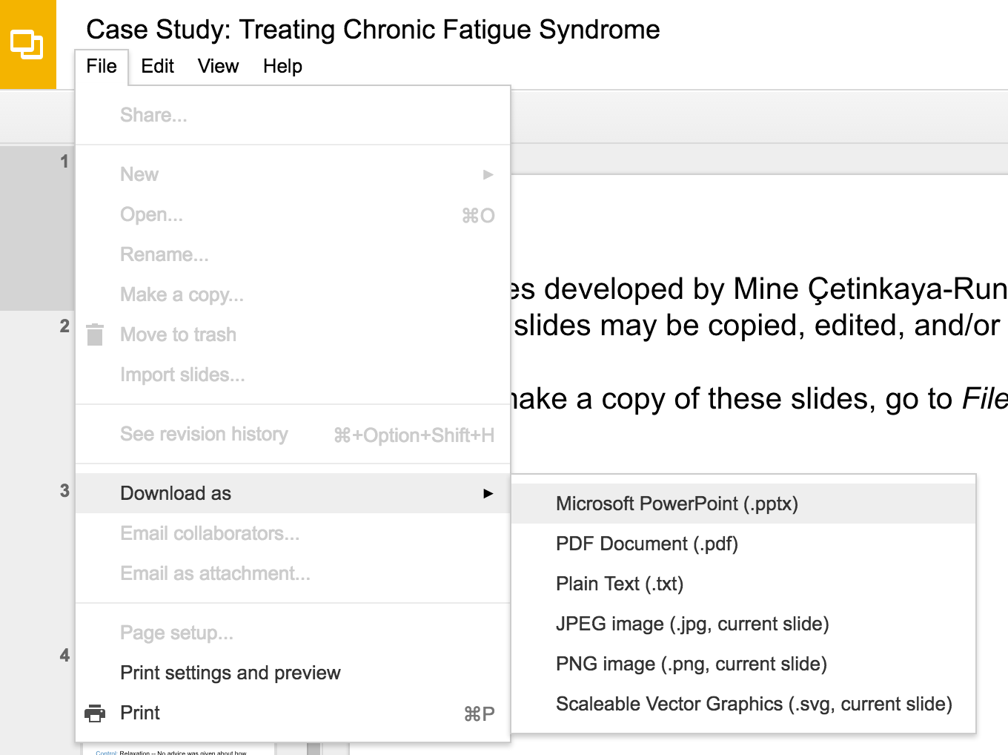
Slides developed by Mine Çetinkaya-Rundel of OpenIntro
Translated from LaTeX to Google Slides by Curry W. Hilton of OpenIntro.
The slides may be copied, edited, and/or shared via the CC BY-SA license
To make a copy of these slides, go to File > Download as > [option], as shown below. Or if you are logged into a Google account, you can choose Make a copy... to create your own version in Google Drive.

Slide 2
Introduction to multiple regression

Slide 3
Multiple regression
Simple linear regression: Bivariate - two variables: y and x
Multiple linear regression: Multiple variables: y and x₁, x₂, · · ·
2

Slide 4

Poverty vs. region (east, west)
Explanatory variable: region, reference level: east
Intercept: The estimated average poverty percentage in eastern states is 11.17%
This is the value we get if we plug in 0 for the explanatory variable
Slope: The estimated average poverty percentage in western states is 0.38% higher than eastern states.
Then, the estimated average poverty percentage in western states is 11.17 + 0.38 = 11.55%.
This is the value we get if we plug in 1 for the explanatory variable
2

Slide 5
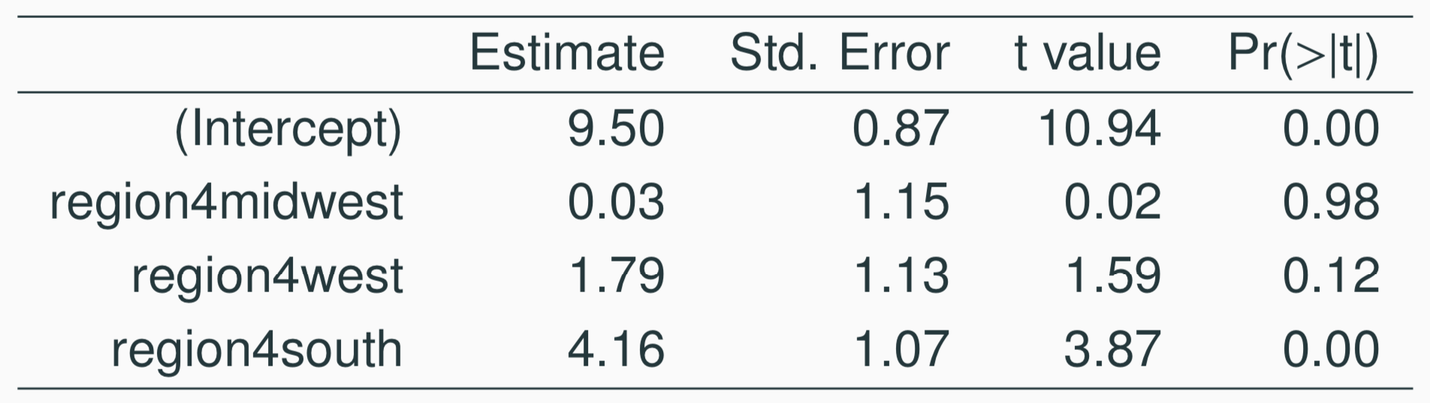
Poverty vs. region (northeast, midwest, west, south)
Which region (northeast, midwest, west, or south) is the reference level?
(a) northeast
(b) midwest
(c) west
(d) south
(e) cannot tell
2

Slide 6
Poverty vs. region (northeast, midwest, west, south)
Which region (northeast, midwest, west, or south) is the reference level?
(a) northeast
(b) midwest
(c) west
(d) south
(e) cannot tell
2

Slide 7
Poverty vs. region (northeast, midwest, west, south)
Which region (northeast, midwest, west, or south) has the lowest poverty percentage?
(a) northeast
(b) midwest
(c) west
(d) south
(e) cannot tell
2

Slide 8
Poverty vs. region (northeast, midwest, west, south)
Which region (northeast, midwest, west, or south) has the lowest poverty percentage?
(a) northeast
(b) midwest
(c) west
(d) south
(e) cannot tell
2

Slide 9
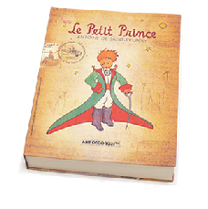
Weights of books
 | weight (g) | volume (cm³) | cover
1 | 800 | 885 | hc
2 | 950 | 1016 | hc
3 | 1050 | 1125 | hc
4 | 350 | 239 | hc
5 | 750 | 701 | hc
6 | 600 | 641 | hc
7 | 1075 | 1228 | hc
8 | 250 | 412 | pb
9 | 700 | 953 | pb
10 | 650 | 929 | pb
11 | 975 | 1492 | pb
12 | 350 | 419 | pb
13 | 950 | 1010 | pb
14 | 425 | 595 | pb
15 | 725 | 1034 | pb
l
h
w
3

Slide 10
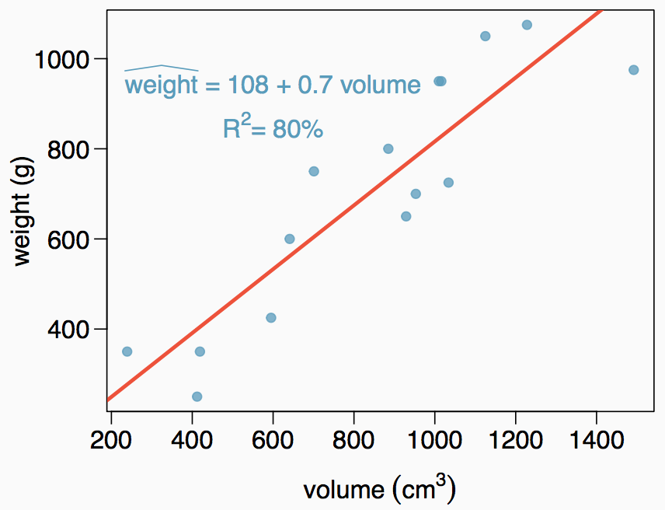
Weights of books (cont.)
The scatterplot shows the relationship between weights and volumes of books as well as the regression output. Which of the below is correct?
Weights of 80% of the books can be predicted accurately using this model.
Books that are 10 cm³ over average are expected to weigh 7g over average.
The correlation between weight and volume is R = 0.80² = 0.64.
The model underestimates the weight of the book with the highest volume.
4

Slide 11
Weights of books (cont.)
The scatterplot shows the relationship between weights and volumes of books as well as the regression output. Which of the below is correct?
Weights of 80% of the books can be predicted accurately using this model.
Books that are 10 cm³ over average are expected to weigh 7g over average.
The correlation between weight and volume is R = 0.80² = 0.64.
The model underestimates the weight of the book with the highest volume.
4

Slide 12
Modeling weights of books using volume
somewhat abbreviated output...
Coefficients:
Estimate Std. Error t value Pr(>|t|)
(Intercept) 107.67931 88.37758 1.218 0.245
Volume 0.70864 0.09746 7.271 6.26e-06
Residual standard error: 123.9 on 13 degrees of freedom Multiple R-squared: 0.8026,Adjusted R-squared: 0.7875
F-statistic: 52.87 on 1 and 13 DF, p-value: 6.262e-06

Slide 13
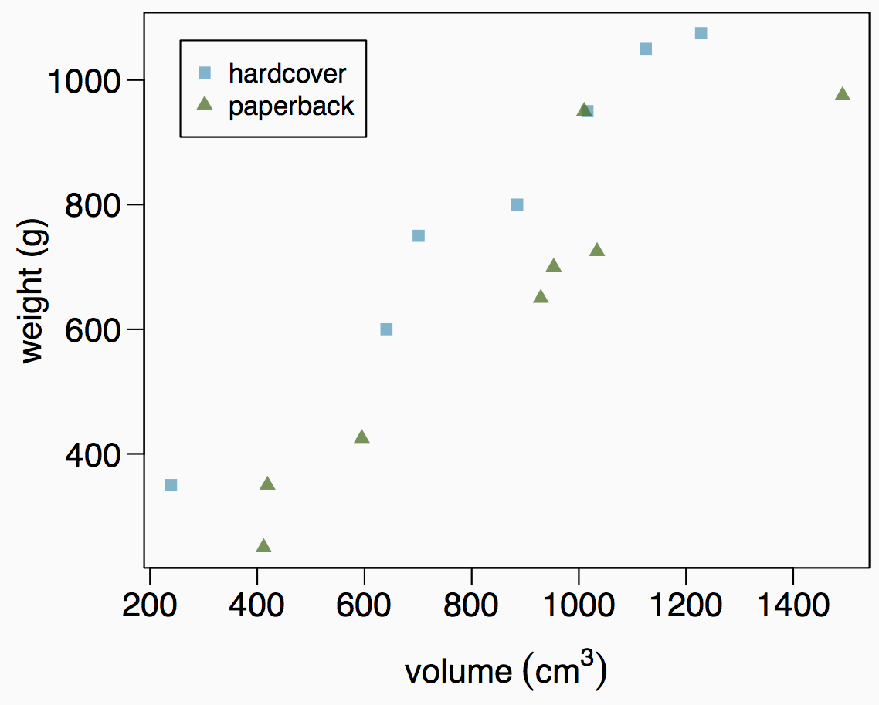
Weights of hardcover and paperback books
Can you identify a trend in the relationship between volume and weight of hardcover and paperback books?

Slide 14
Weights of hardcover and paperback books
Can you identify a trend in the relationship between volume and weight of hardcover and paperback books?
Paperbacks generally weigh less than hardcover books after controlling for the book's volume.

Slide 15
Modeling weights of books using volume and cover type
Coefficients:
 | Estimate | Std. Error | t value | Pr(>|t|)
(Intercept) | 197.96284 | 59.19274 | 3.344 | 0.005841 | **
volume | 0.71795 | 0.06153 | 11.669 | 6.6e-08 | ***
cover:pb | -184.04727 | 40.49420 | -4.545 | 0.000672 | ***
Residual standard error: 78.2 on 12 degrees of freedom Multiple R-squared: 0.9275,Adjusted R-squared: 0.9154 F-statistic: 76.73 on 2 and 12 DF, p-value: 1.455e-07

Slide 16
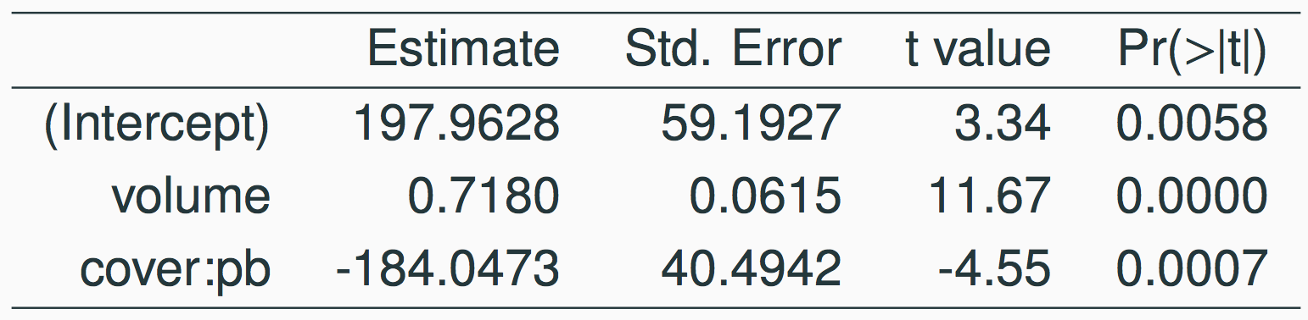
Determining the reference level
Based on the regression output below, which level of cover is the reference level? Note that pb: paperback.
paperback
hardcover
8

Slide 17
Determining the reference level
Based on the regression output below, which level of cover is the reference level? Note that pb: paperback.
paperback
hardcover
8

Slide 18
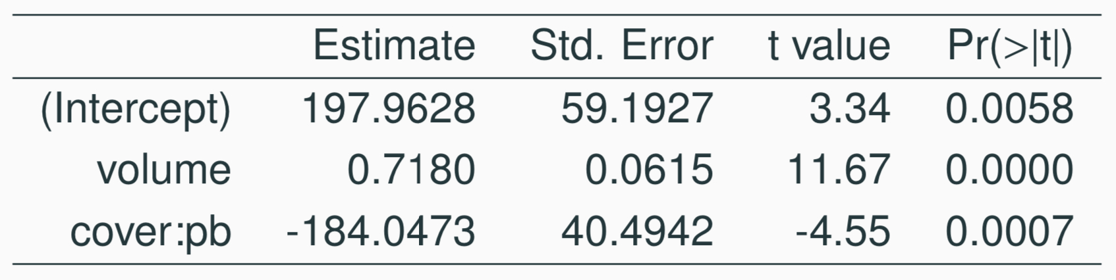
Determining the reference level
Which of the below correctly describes the roles of variables in this regression model?
response: weight, explanatory: volume, paperback cover
response: weight, explanatory: volume, hardcover cover
response: volume, explanatory: weight, cover type
response: weight, explanatory: volume, cover type
9

Slide 19
Determining the reference level
Which of the below correctly describes the roles of variables in this regression model?
response: weight, explanatory: volume, paperback cover
response: weight, explanatory: volume, hardcover cover
response: volume, explanatory: weight, cover type
response: weight, explanatory: volume, cover type
9

Slide 20
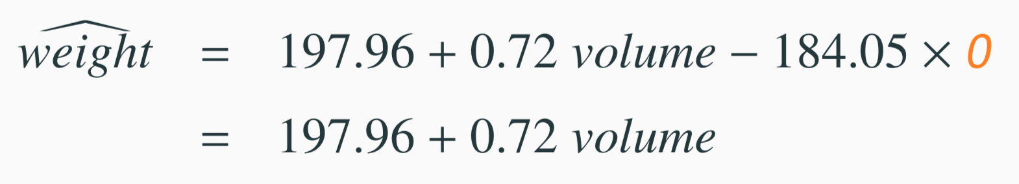
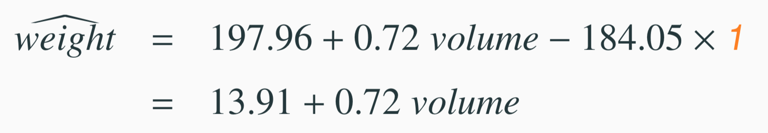
Linear Model
Estimate Std. Error t value Pr(>|t|)
(Intercept) | 197.96 | 59.19 | 3.34 | 0.01
volume | 0.72 | 0.06 | 11.67 | 0.00
cover:pb | -184.05 | 40.49 | -4.55 | 0.00
1. For hardcover books: plug in 0 for cover
2. For paperback books: plug in 1 for cover
12

Slide 21
Visualising the linear model
1000
hardcover paperback
800
600
400
weight (g)
200 400 600 800 1000 1200 1400
volume (cm³)

Slide 22
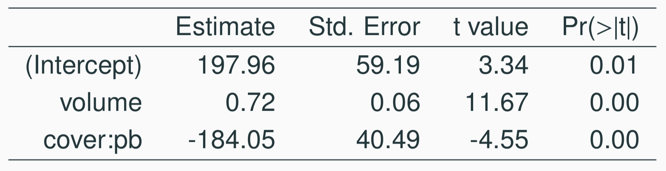
Linear model
Slope of volume: All else held constant, books that are 1 more cubic centimeter in volume tend to weigh about 0.72 grams more.
Slope of cover: All else held constant, the model predicts that paperback books weigh 184 grams lower than hardcover books.
Intercept: Hardcover books with no volume are expected on average to weigh 198 grams.
Obviously, the intercept does not make sense in context. It only serves to adjust the height of the line.
10

Slide 23
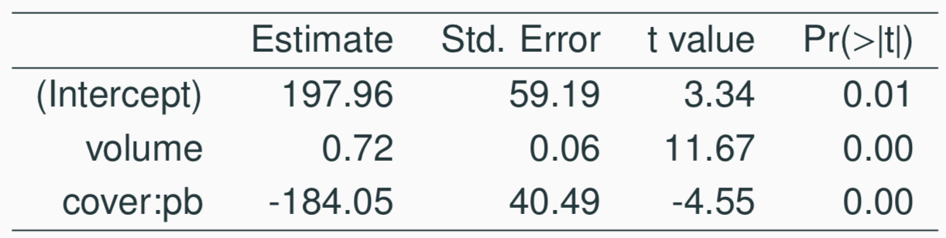
Prediction
Which of the following is the correct calculation for the predicted weight of a paperback book that is 600 cm³?
(a) 197.96 + 0.72 * 600 - 184.05 * 1
(b) 184.05 + 0.72 * 600 - 197.96 * 1
(c) 197.96 + 0.72 * 600 - 184.05 * 0
(d) 197.96 + 0.72 * 1 - 184.05 * 600
13

Slide 24
Prediction
Which of the following is the correct calculation for the predicted weight of a paperback book that is 600 cm³?
(a) 197.96 + 0.72 * 600 - 184.05 * 1
(b) 184.05 + 0.72 * 600 - 197.96 * 1
(c) 197.96 + 0.72 * 600 - 184.05 * 0
(d) 197.96 + 0.72 * 1 - 184.05 * 600
13

Slide 25
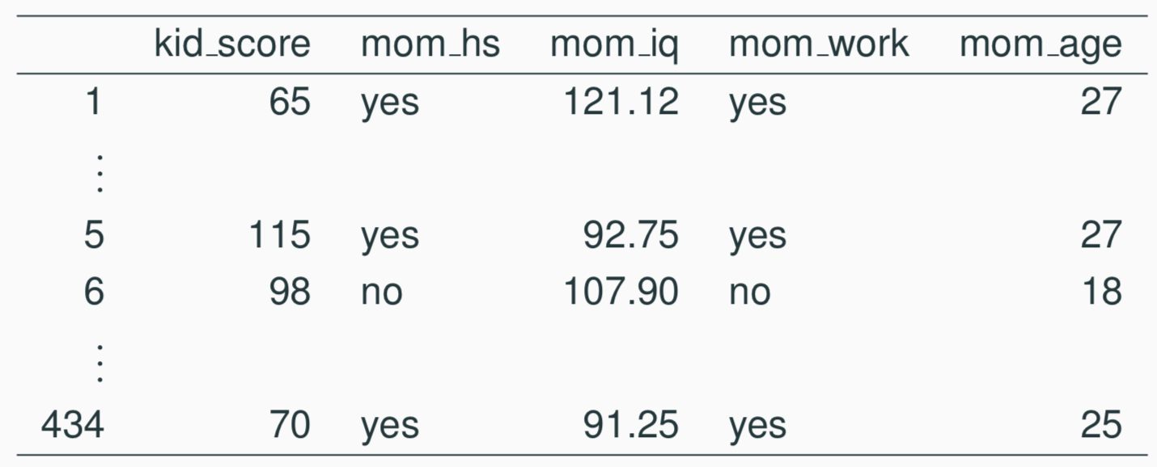
Another example: Modeling kid’s test scores
Predicting cognitive test scores of three- and four-year-old children using characteristics of their mothers. Data are from a survey of adult American women and their children - a subsample from the National Longitudinal Survey of Youth.
Gelman, Hill. Data Analysis Using Regression and Multilevel/Hierarchical Models. (2007) Cambridge University Press.

Slide 26
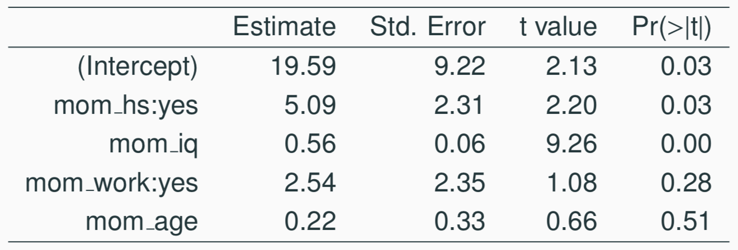
Interpreting the slope
What is the correct interpretation of the slope for mom’s IQ?
15

Slide 27
Interpreting the slope
What is the correct interpretation of the slope for mom’s IQ?
All else held constant, kids with mothers whose IQs are one point higher tend to score on average 0.56 points higher.
15

Slide 28
Interpreting the slope
What is the correct interpretation of the intercept?
15

Slide 29
Interpreting the slope
What is the correct interpretation of the intercept?
Kids whose moms haven’t gone to HS, did three years of the kid’s life, have an IQ of 0 expected on average to score 19.59.
Obviously, the intercept does not make any sense in context.
15

Slide 30
Interpreting the slope
What is the correct interpretation of mom_work?
All else being equal, kids whose moms worked during the first three years of the kid’s life
(a) are estimated to score 2.54 points lower
(b) are estimated to score 2.54 points higher
than those whose moms did not work.
15

Slide 31
Interpreting the slope
What is the correct interpretation of mom_work?
All else being equal, kids whose moms worked during the first three years of the kid’s life
(a) are estimated to score 2.54 points lower
(b) are estimated to score 2.54 points higher
than those whose moms did not work.
15

Slide 32
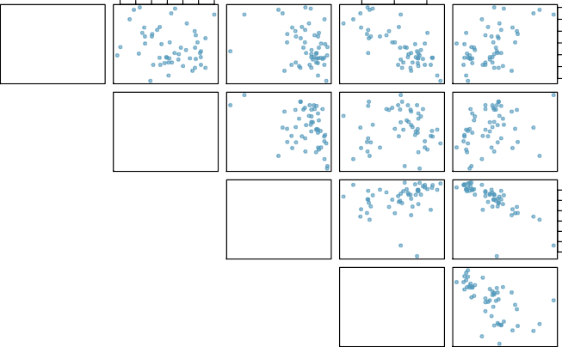
Revisit: Modeling poverty
40 50 60 70 80 90 100
80
85
90
poverty
6 8 10 14 18
100
80
metro_res
60
−0.20
40
−0.31
−0.34
white
30 50 70 90
90
0.018
0.24
85
−0.75
hs_grad
80
0.30
−0.61
0.53
−0.75
female_house
8 10 14 18
6 8 10 12 14 16 18
30 50 70 90
8 10 12 14 16 18

Slide 33
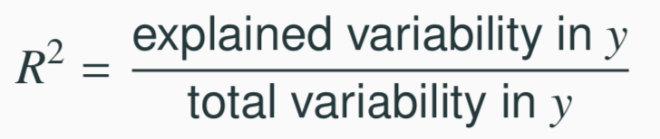
Another look at R²
R² can be calculated in three ways:
square the correlation coefficient of x and y (how we have been calculating it)
square the correlation coefficient of y and ŷ
based on definition:
Using ANOVA we can calculate the explained variability and total variability in y.
20

Slide 34
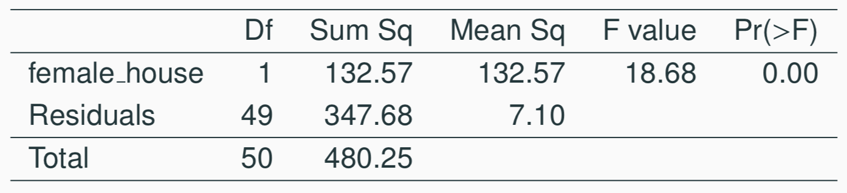
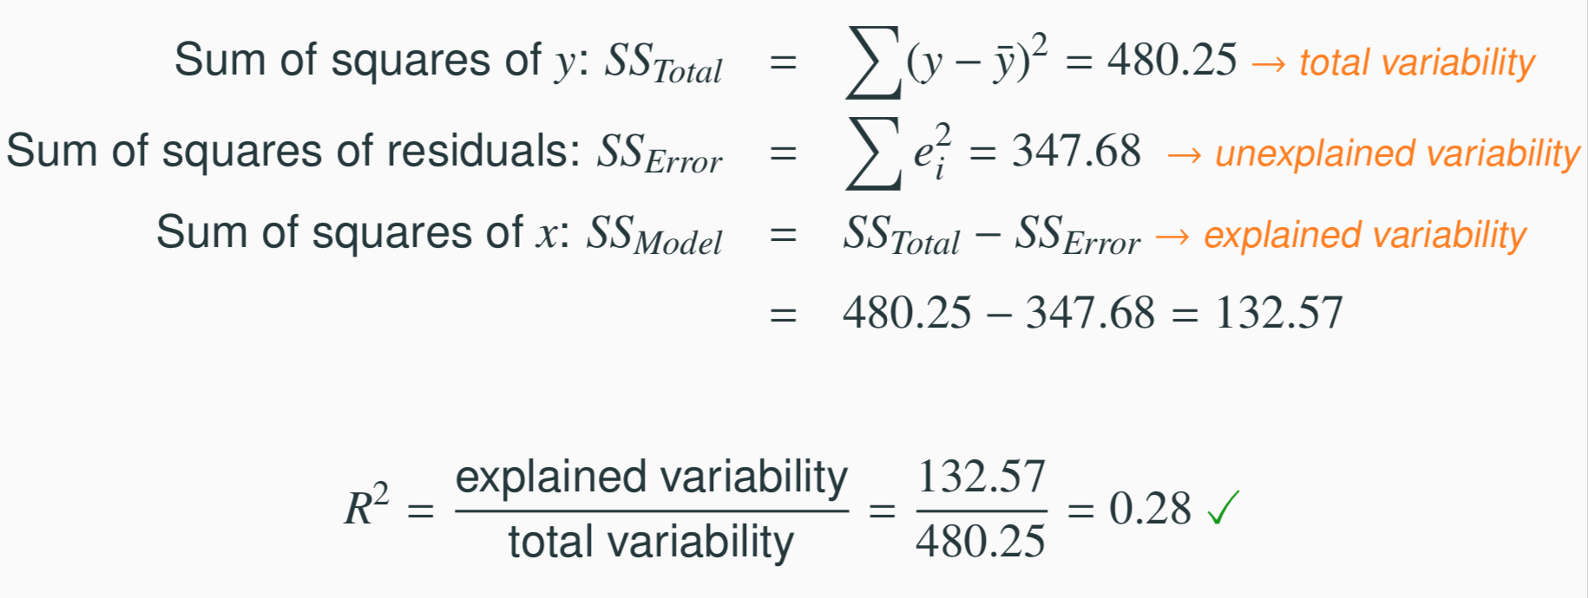
Sum of squares
21

Slide 35
Why bother?
Why bother with another approach for calculating R² when we had a perfectly good way to calculate it as the correlation coefficient squared?
22

Slide 36
Why bother?
Why bother with another approach for calculating R² when we had a perfectly good way to calculate it as the correlation coefficient squared?
For single-predictor linear regression, having three ways to calculate the same value may seem like overkill.
However, in multiple linear regression, we can’t calculate R² as the square of the correlation between x and y because we have multiple xs.
And next we’ll learn another measure of explained variability, adjusted R², that requires the use of the third approach, ratio of explained and unexplained variability.
22

Slide 37
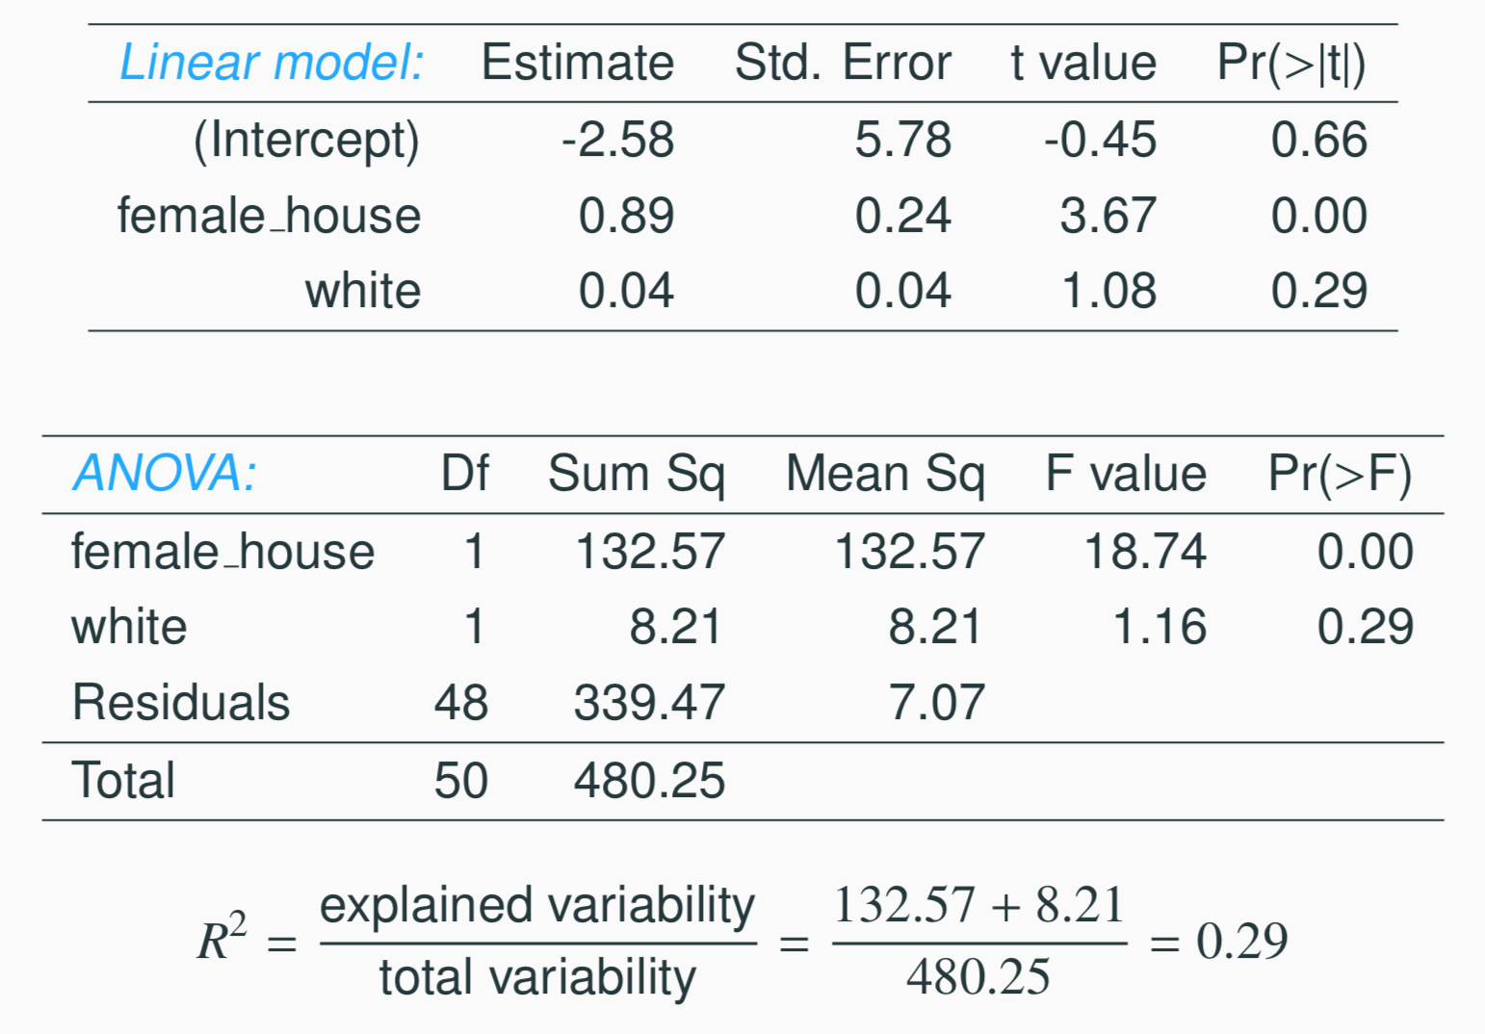
Predicting poverty using % female hh + % white
23

Slide 38
Predicting poverty using % female hh + % white
23

Slide 39
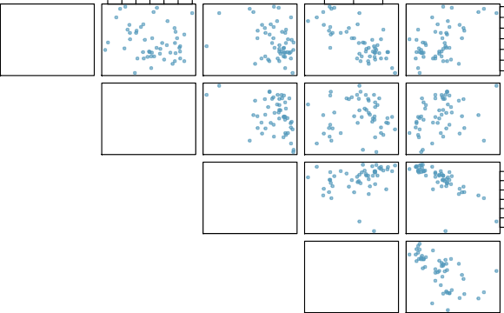
Does adding the variable white to the model add valuable informa- tion that wasn’t provided by female house?
40 50 60 70 80 90 100
80
85
90
poverty
6 8 10 14 18
100
−0.20
80
metro_res
60
40
−0.31
−0.34
white
30 50 70 90
90
−0.75
0.018
0.24
85
hs_grad
80
0.30
−0.61
0.53
−0.75
30 50 70 90
female_house
8 10 14 18
6 8 10 12 14 16 18
8 10 12 14 16 18

Slide 40
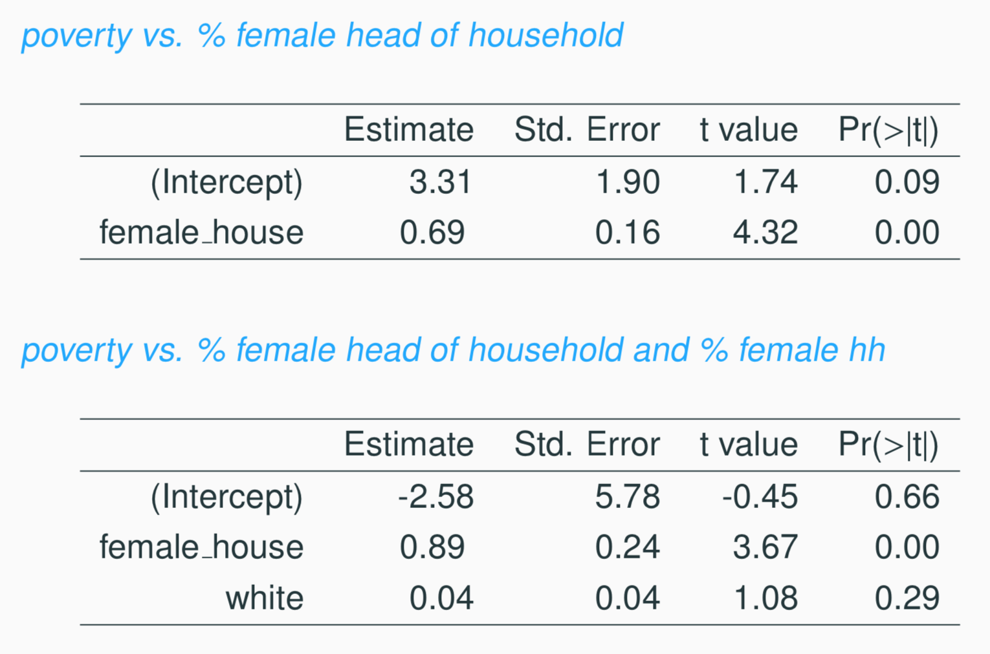
Collinearity between explanatory variables
25

Slide 41
Collinearity between explanatory variables (cont.)
Two predictor variables are said to be collinear when they are correlated, and this collinearity complicates model estimation.
Remember: Predictors are also called explanatory or independent variables. Ideally, they would be independent of each other.
26

Slide 42
Collinearity between explanatory variables (cont.)
Two predictor variables are said to be collinear when they are correlated, and this collinearity complicates model estimation. Remember: Predictors are also called explanatory or independent variables. Ideally, they would be independent of each other.
We don’t like adding predictors that are associated with each other to the model, because often times the addition of such variable brings nothing to the table. Instead, we prefer the simplest best model, i.e. parsimonious model.
While it’s impossible to avoid collinearity from arising in observational data, experiments are usually designed to prevent correlation among predictors.
26

Slide 43
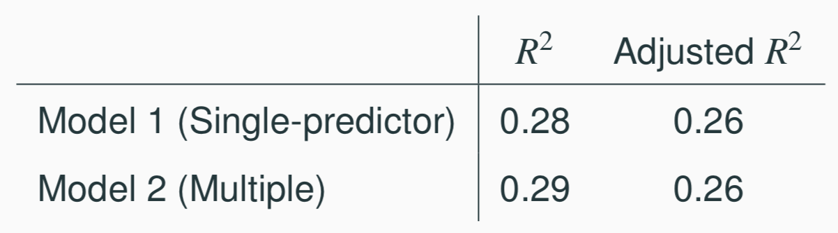
R² vs. adjusted R²
When any variable is added to the model R² increases.
But if the added variable doesn’t really provide any new information, or is completely unrelated, adjusted R² does not increase.
27

Slide 44
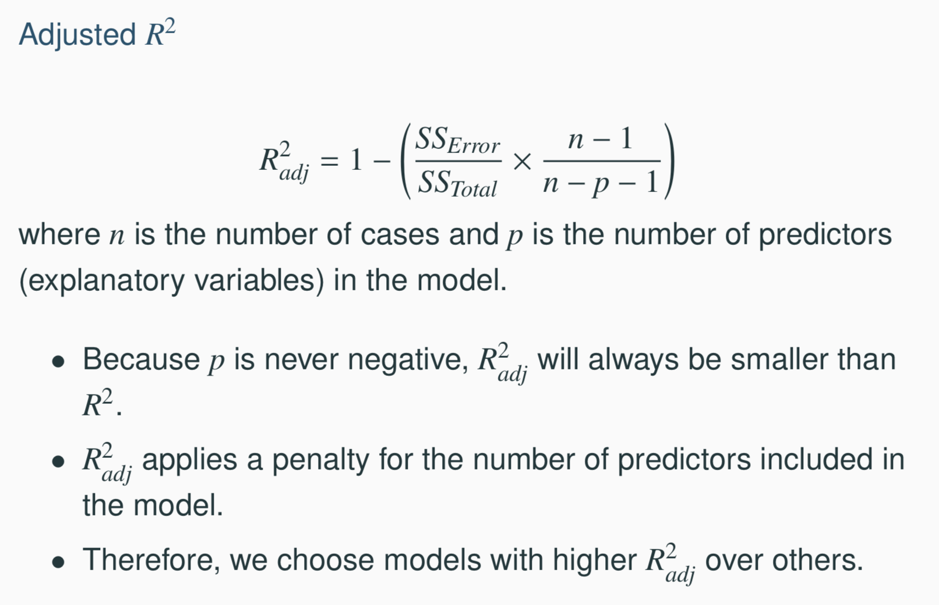
R² vs. adjusted R²
27

Slide 45
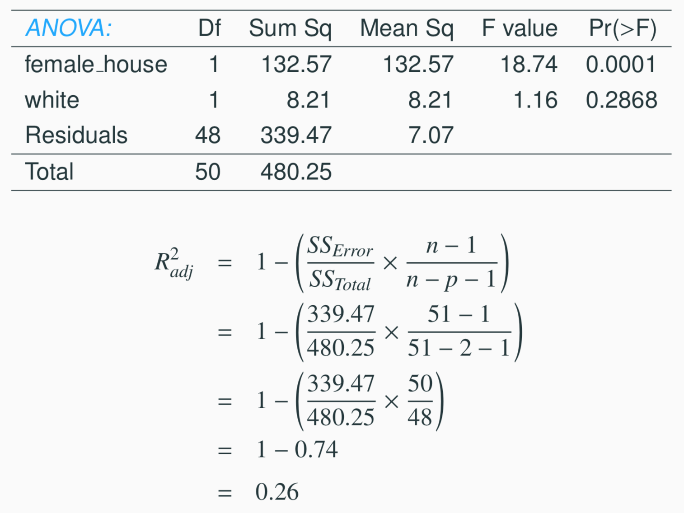
Calculate adjusted R²
27

Slide 46
Find more resources at openintro.org/os, including
Slides
Videos
Statistical Software Labs
Discussion Forums (free support for students and teachers)
Learning Objectives
Teachers only content is also available for Verified Teachers, including
Exercise solutions
Sample exams
Ability to request a free desk copy for a course
Statistics Teachers email group
Questions? Contact us.

